Slide 1
ANOMALY DETECTION
Most of the material in this presentation taken from Text Book slides (Tan et. al.)

Slide 2
Distance‐Based Approaches
Several different techniques
An object is an outlier if a specified fraction of the objects is more than a specified distance away (Knorr, Ng 1998)
Some statistical definitions are special cases of this
The outlier score of an object is the distance to its kth nearest neighbor

Slide 3
Distance-based Approaches
Data is represented as a vector of features
Three major approaches
Nearest-neighbor based
Density based
Clustering based

Slide 4
Nearest-Neighbor Based Approach
Approach:
Compute the distance between every pair of data points
Outlier score of an object is given by the distance to its k-nearest neighbor
There are various ways to define outliers:
Data points for which there are fewer than p neighboring points within a distance D
The top n data points whose distance to the kth nearest neighbor is greatest
The top n data points whose average distance to the k nearest neighbors is greatest

Slide 5
Nearest-Neighbor Based Approach
K=5

Slide 6
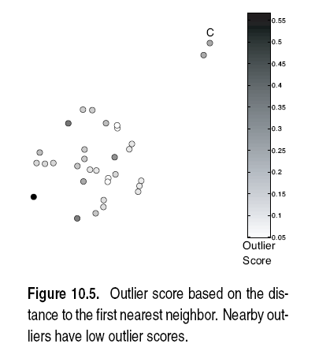
Nearest-Neighbor Based Approach
Approach highly sensitive to choice of K
K=1

Slide 7
Nearest-Neighbor Based Approach
Approach highly sensitive to choice of K
K=5
All points in smaller cluster have high Outlier Score
How to reduce sensitivity on K?
Complexity?

Slide 8
Nearest-Neighbor Based Approach
Strengths & Weaknesses
+ simple
Complexity O(m²)
Sensitive to choice of parameters
Wide density variations not handles properly (global thresholds are used)
Distance becomes less meaningful in high dimensional space

Slide 9
Nearest-Neighbor Based Approach

Slide 10
Density‐Based Approaches
Density‐based Outlier: The outlier score of an object is the inverse of the density around the object.
Can be defined in terms of the k nearest neighbors
One definition: Inverse of distance to kth neighbor
Another definition: Inverse of the average distance to k neighbors
DBSCAN definition
If there are regions of different density, this approach can have problems

Slide 11
Relative Density
Consider the density of a point relative to that of its k nearest neighbors

Slide 13
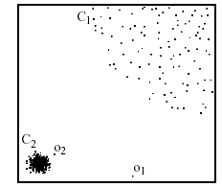
Density-based: LOF approach
For each point, compute the density of its local neighborhood
Compute local outlier factor (LOF) of a sample p as the average of the ratios of the density of sample p and the density of its nearest neighbors
Outliers are points with largest LOF value
In the NN approach, p₂ is not considered as outlier, while LOF approach find both p₁ and p₂ as outliers
p₂
×
p₁
×

Slide 14
Strengths/Weaknesses of Density‐Based Approaches
Simple
Expensive – O(n2)
Sensitive to parameters
Density becomes less meaningful in high dimensional space

Slide 15
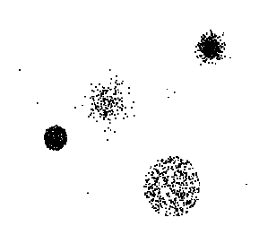
Clustering-Based
Basic idea:
Cluster the data into groups of different density
Choose points in small cluster as candidate outliers
Compute the distance between candidate points and non-candidate clusters.
If candidate points are far from all other non-candidate points, they are outliers

Slide 16
Clustering‐Based Approaches
Clustering‐based Outlier: An object is a cluster‐based outlier if it does not strongly belong to any cluster
For prototype‐based clusters, an object is an outlier if it is not close enough to a cluster center
For density‐based clusters, an object is an outlier if its density is too low
For graph‐based clusters, an object is an outlier if it is not well connected
Other issues include the impact of outliers on the clusters and the number of clusters

Slide 19
Strengths/Weaknesses of Cluster‐Based Approaches
Simple
Many clustering techniques can be used
Can be difficult to decide on a clustering technique
Can be difficult to decide on number of clusters
Outliers can distort the clusters

Slide 20
Outliers in Lower Dimensional Projection
In high-dimensional space, data is sparse and notion of proximity becomes meaningless
Every point is an almost equally good outlier from the perspective of proximity-based definitions
Lower-dimensional projection methods
A point is an outlier if in some lower dimensional projection, it is present in a local region of abnormally low density

Slide 21

Outliers in Lower Dimensional Projection
Divide each attribute into φ equal-depth intervals
Each interval contains a fraction f = 1/φ of the records
Consider a k-dimensional cube created by picking grid ranges from k different dimensions
If attributes are independent, we expect region to contain a fraction f^{k} of the records
If there are N points, we can measure sparsity of a cube D as:
Negative sparsity indicates cube contains smaller number of points than expected

Slide 22
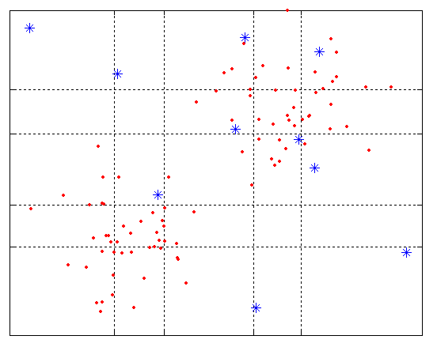
Example
N=100, φ = 5, f = 1/5 = 0.2, N × f² = 4

